Slide 1


AJAY VIJAYAN
09/02/2025

Slide 2
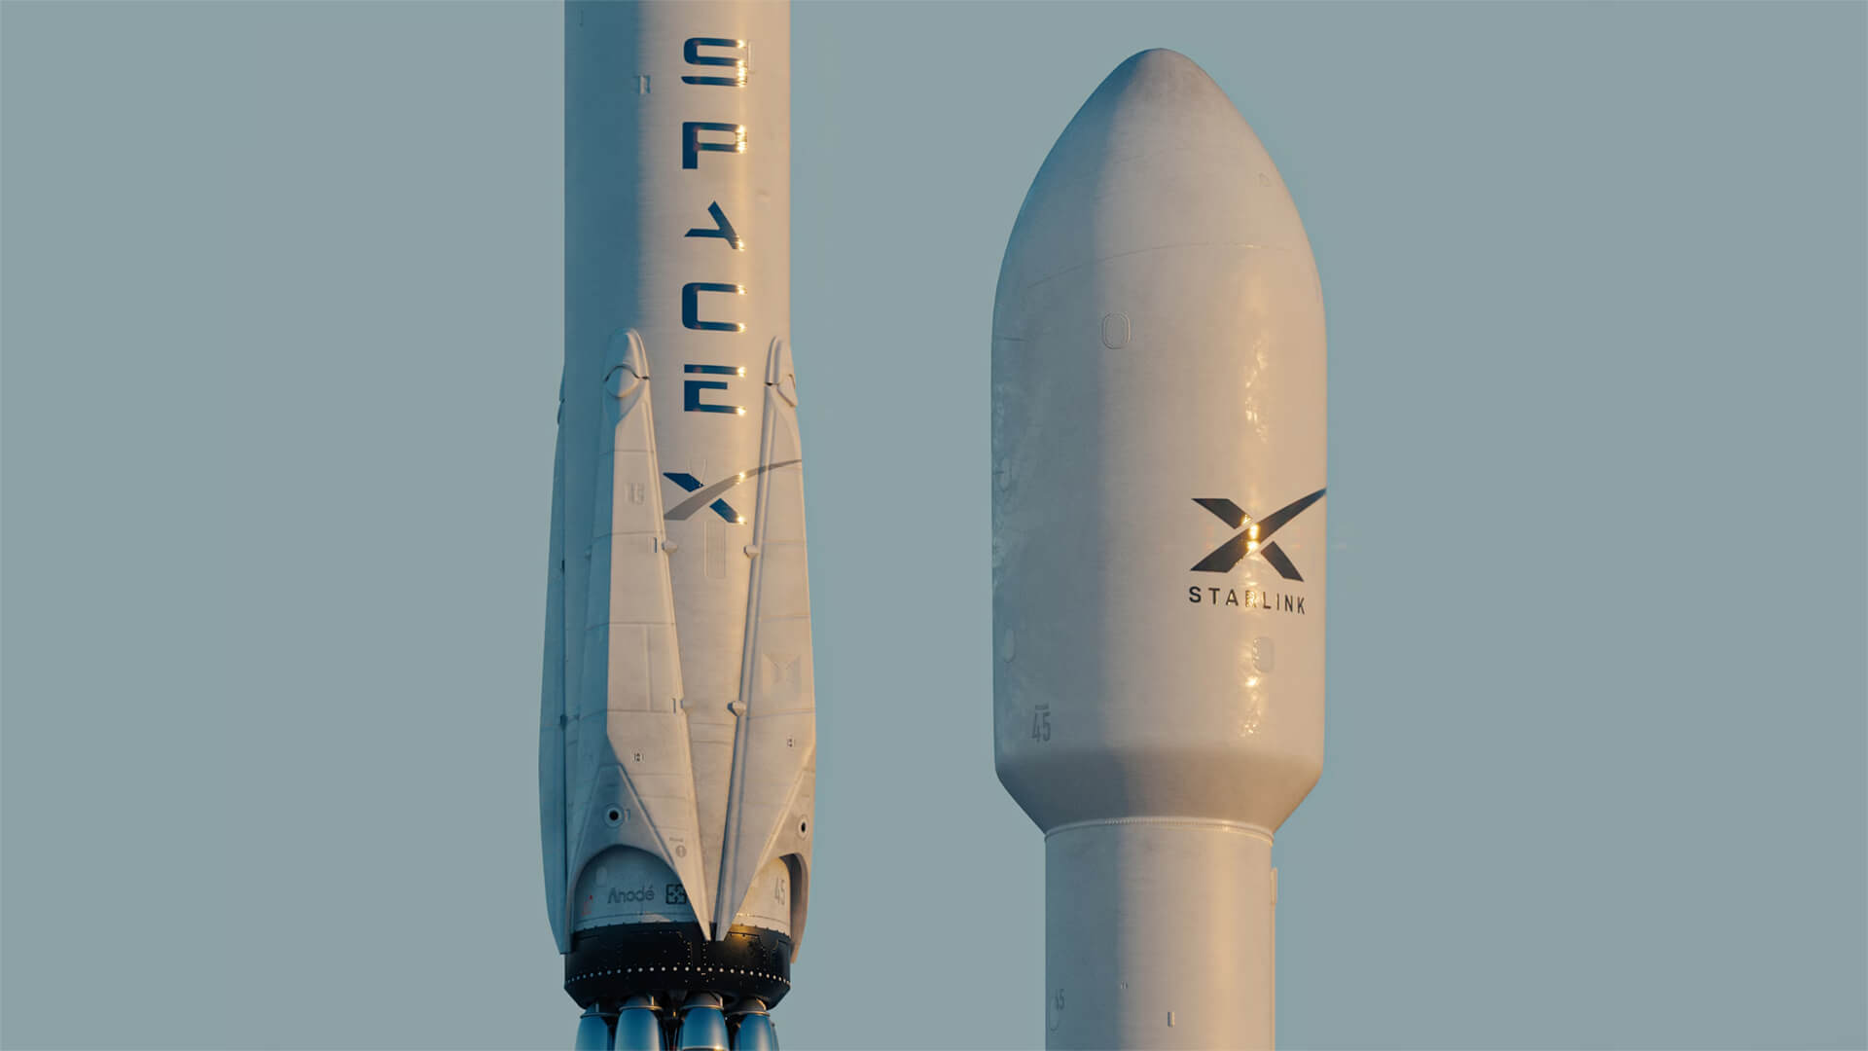
Outline
Executive Summary
Introduction
Methodology
Results
Conclusion
Appendix

Slide 3

Executive Summary
Summary of methodologies
Data Collection through API
Data Collection with Web Scraping
Data Wrangling
Exploratory Data Analysis with SQL
Exploratory Data Analysis with Data Visualization
Interactive Visual Analytics with Folium
Machine Learning Prediction
Summary of all results
Exploratory Data Analysis result
Interactive analytics in screenshots
Predictive Analytics result

Slide 4
Introduction
Project background and context
Space Exploration Technologies Corp. (SpaceX) is an American aerospace manufacturer and space transportation company founded by Elon Musk in 2002. It is one of the most innovative private space companies, revolutionizing space travel with reusable rockets, ambitious Mars colonization plans, and satellite projects like Starlink.
SpaceX advertises Falcon9 rocket launches on its website with a cost of 62 million dollars; other providers cost upward of 165 million dollars each, much of the savings are because they can reuse the first stage. Therefore, if we can determine if the first stage will land, we can determine the cost of a launch. This information can be used if an alternate company wants to bid against SpaceX for a rocket launch. This goal of the project is to create a machine learning pipeline to predict if the first stage will land successfully.
Problems you want to find answers
What factors determine if the rocket will land successfully?
The interaction amongst various features that determine the success rate of a successful landing.
What operating conditions needs to be in place to ensure a successful landing program.

Slide 5

Section 1

Slide 6
Methodology
Executive Summary
Data collection methodology:
Data was collected using SpaceX API and Web Scraping from Wikipedia.
Perform data wrangling
Data is filtered, encoded and cleaned for further analysis.
Perform exploratory data analysis (EDA) using visualization and SQL
Perform interactive visual analytics using Folium and Plotly Dash
Perform predictive analysis using classification models
How to build, tune, evaluate classification models

Slide 7
Data Collection
Data collection process involved a combination of API requests from SpaceX REST API and Web Scraping data from a table in SpaceX’s Wikipedia entry. We had to use both of these data collection methods in order to get complete information about the launches for a more detailed analysis.
Data Columns obtained by using SpaceX REST API:
FlightNumber, Date, BoosterVersion, PayloadMass, Orbit, LaunchSite, Outcome, Flights, GridFins, Reused, Legs, LandingPad, Block, ReusedCount, Serial, Longitude, Latitude.
Data Columns obtained by using Wikipedia Web Scraping:
Flight No., Launch site, Payload, PayloadMass, Orbit, Customer, Launch outcome, Version Booster, Booster landing, Date, Time

Slide 8
Data Collection – SpaceX API
Present your data collection with SpaceX REST calls using key phrases and flowcharts
Refer to my GitHub URL of the completed SpaceX API calls notebook:
Request rocket launch data from SpaceX API
Decoding the response content using .json() and turning it into a DataFrame)
Requesting needed information about the launches from SpaceX API by applying custom Functions
Creating a DataFrame from the dictionary
Filtering the DataFrame to only include Falcon 9 launches
Replacing missing values of Payload Mass column with calculated .mean() for this column
Exporting the data to CSV
Constructing data we have obtained into a dictionary

Slide 9
Data Collection - Scraping
Present your web scraping process using key phrases and flowcharts
Refer to my GitHub URL of the completed WebScraping data notebook:
Requesting Falcon 9 launch data from Wikipedia
Creating a BeautifulSoup object from the HTML response
Extracting column names from the HTML table header
Exporting the data to CSV
Collecting the data by parsing HTML tables

Slide 10
Data Wrangling
In the dataset, there are several cases where the booster did not land successfully. Sometimes a landing was attempted but failed due to an accident.
Ocean Landing: A successful landing in a specific region of the ocean (True Ocean) or an unsuccessful landing in the ocean (False Ocean).
RTLS (Return to Launch Site) Landing: A successful landing on a ground pad (True RTLS) or an unsuccessful landing on a ground pad (False RTLS).
ASDS (Autonomous Spaceport Drone Ship) Landing: A successful landing on a drone ship (True ASDS) or an unsuccessful landing on a drone ship (False ASDS).
To standardize these outcomes, we convert them into training labels:
"1" means the booster successfully landed.
"0" means the booster was unsuccessful.
GitHub URL: 04_DataWrangling

Slide 11
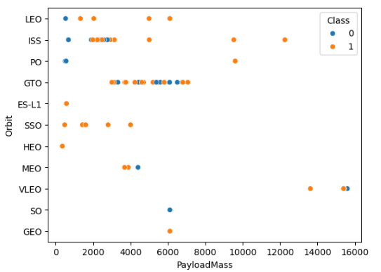
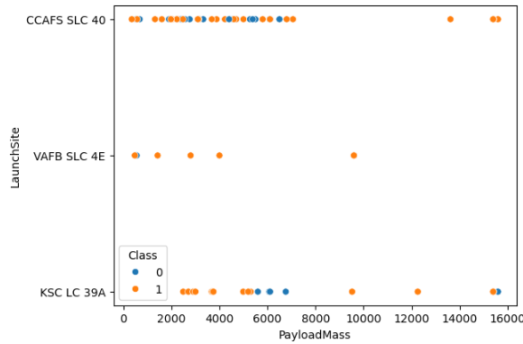
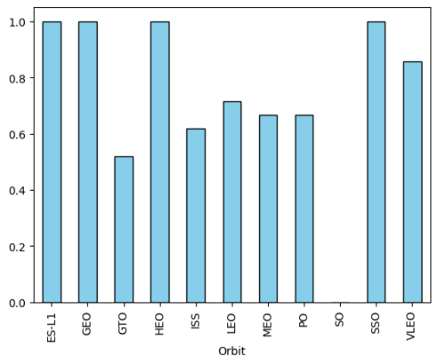
EDA with Data Visualization
To explore data, scatterplots and bar plots were used to visualize the relationship between pair of features:
Payload Mass vs Flight Number, Launch Site vs Flight Number, Launch Site vs Payload Mass, Orbit vs Flight Number, Payload vs Orbit
GitHub URL: 06 EDA_DataVisualisation

Slide 12
EDA with SQL
The following SQL queries were performed:
Unique launch site names.
Top 5 launch sites starting with 'CCA'.
Total payload mass of NASA (CRS) launches.
Average payload mass for F9 v1.1 boosters.
Date of the first successful ground pad landing.
Boosters with successful drone ship landings and payloads between 4000 kgs and 6000 kgs.
Total successful and failed missions.
Booster versions carrying the maximum payload.
Failed drone ship landings in 2015 with booster versions and launch sites.
Ranking of landing outcomes between 2010-06-04 and 2017-03-20.
GitHub URL: 05_EDA_SQL

Slide 13
Build an Interactive Map with Folium
Markers of all Launch Sites: - Added Marker with Circle, Popup Label and Text Label of NASA Johnson Space Center using its latitude and longitude coordinates as a start location. Added Markers with Circle, Popup Label and Text Label of all Launch Sites using their latitude and longitude coordinates to show their geographical locations and proximity to Equator and coasts.
Colored Markers of the launch outcomes for each Launch Site: Added colored Markers of success (Green) and failed (Red) launches using Marker Cluster to identify which launch sites have relatively high success rates.
Distances between a Launch Site to its proximities: - Added colored Lines to show distances between the Launch Site KSC LC-39A (as an example) and its proximities like Railway, Highway, Coastline and Closest City
GitHub URL: 07_InteractiveVisuals_Folium

Slide 14
Build a Dashboard with Plotly Dash
Launch Sites Dropdown List: Added a dropdown list to enable Launch Site selection
Pie Chart showing Success Launches (All Sites/Certain Site): Added a pie chart to show the total successful launches count for all sites and the Success vs. Failed counts for the site, if a specific Launch Site was selected.
Slider of Payload Mass Range: Added a slider to select Payload range.
Scatter Chart of Payload Mass vs. Success Rate for the different Booster Versions: Added a scatter chart to show the correlation between Payload and Launch success
GitHub URL: 08_InteractiveVisuals_Plotly

Slide 15
Predictive Analysis (Classification)
We loaded the data using NumPy and Pandas, transformed the data, split our data into training and testing.
We built different machine learning models and tune different hyperparameters using GridSearchCV.
Accuracy is used to evaluate the model performance. The model was further improved the model using feature engineering and algorithm tuning.
We found the best performing classification model which was Decision Trees.
Creating a NumPy array from “Class ” columns
Standardizing the data
Train Test Split
Hyper Parameter Tuning with GridSearchCV
Accuracy calculation
Confusion Matrix
Finding the best model
GitHub URL: 09_PredictiveAnalysis

Slide 16
Results
Exploratory data analysis results
Launch success has improved over time
KSC LC-39A has the highest success rate among landing sites
Orbits ES-L1, GEO, HEO and SSO have a 100% success rate
Interactive analytics demo in screenshots
Most launch sites are near the equator, and all are close to the coast.
Launch sites are far enough away from anything a failed launch can damage (city, highway, railway), while still close enough to bring people and material to support launch activities
Predictive analysis results
Decision Tree model is the best predictive model for the dataset

Slide 17

Section 2

Slide 18
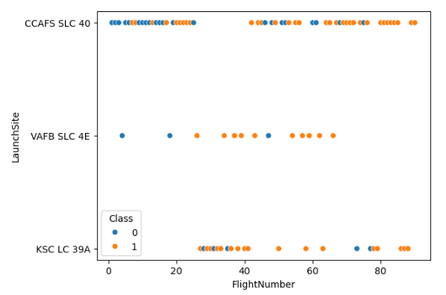
Flight Number vs. Launch Site
Flight Number vs. Launch Site
The earliest flights all failed while all the recent flights succeeded.
The CCAFS SLC 40 launch site accounts for nearly half of all launches.
VAFB SLC 4E and KSC LC 39A have higher success rates.
Success rate appears to improve with each new launch.

Slide 19
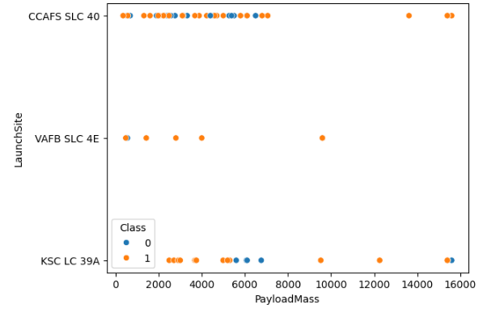
Payload vs. Launch Site
Payload vs. Launch Site
Higher payload mass generally leads to higher success rates across all launch sites.
Most launches with payloads over 7000 kg were successful.
KSC LC 39A has a 100% success rate for payloads under 5500 kgs.

Slide 20
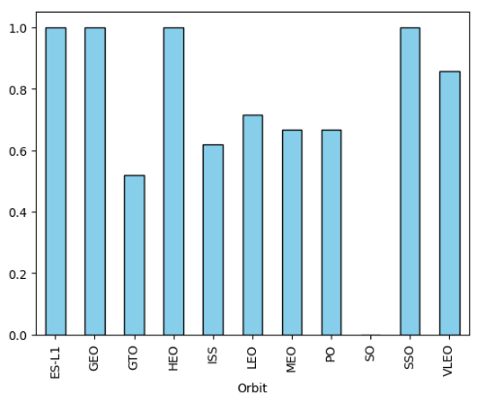
Success Rate vs. Orbit Type
Success Rates
Earth-Sun Lagrange Point 1 (ES-L1), Geostationary Orbit (GEO), Highly Elliptical Orbit (HEO), Sun-Synchronous Orbit (SSO) have a 100% success rate.
The success rate Space Orbit (SO) is 0%.
Geostationary Transfer Orbit (GTO), International Space Station Orbit (ISS), Low Earth Orbit (LEO), Medium Earth Orbit (MEO) and Polar Orbit (PO) has success rates between 50% and 85%

Slide 21
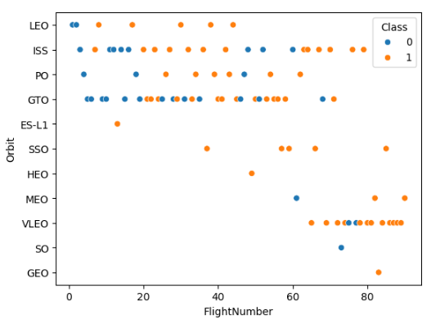
Flight Number vs. Orbit Type
Flight number vs. Orbit type
It is observed that in the LEO orbit, success seems to be related to the number of flights.
Conversely, in the GTO orbit, there appears to be no relationship between flight number and success.

Slide 22
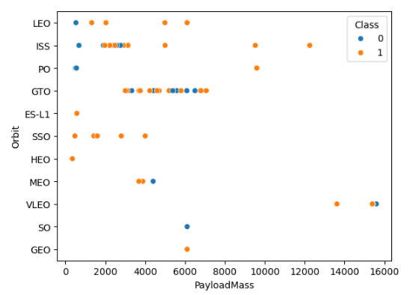
Payload vs. Orbit Type
Payload vs. Orbit type
With heavy payloads the successful landing or positive landing rate are more for Polar Orbit (PO), Low Earth Orbit (LEO) and International Space Station (ISS).
However, for GTO, it's difficult to distinguish between successful and unsuccessful landings as both outcomes are present.

Slide 23
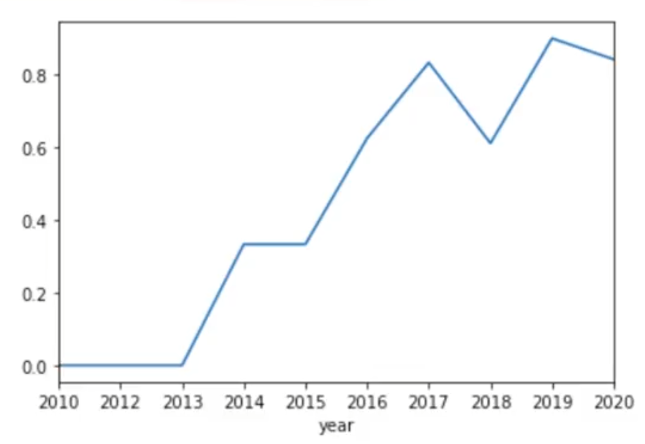
Launch Success Yearly Trend
Yearly average success rate
A line chart was plotted with its x-axis to be Year and y-axis to be average success rate, to get the average launch success trend.
It can be observed that the success rate since 2013 kept increasing till 2020 and this trend is expected to continue.

Slide 24
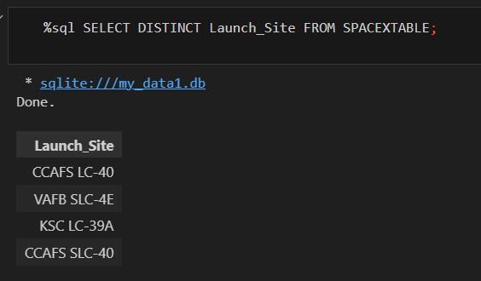
All Launch Site Names
The names of the unique launch sites are queried using SQL
SpaceX Launch Sites Overview:
CCAFS LC-40 (Cape Canaveral Space Force Station, Launch Complex 40)
VAFB SLC-4E (Vandenberg Space Force Base, Space Launch Complex 4E)
KSC LC-39A (Kennedy Space Center, Launch Complex 39A)
CCAFS SLC-40 (Cape Canaveral Space Force Station, Space Launch Complex 40)

Slide 25
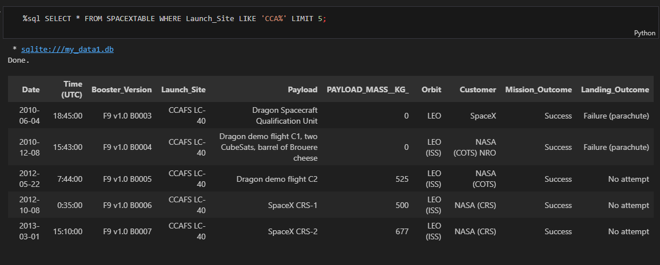
Launch Site Names Begin with 'CCA'
Records where launch sites begin with `CCA`

Slide 26
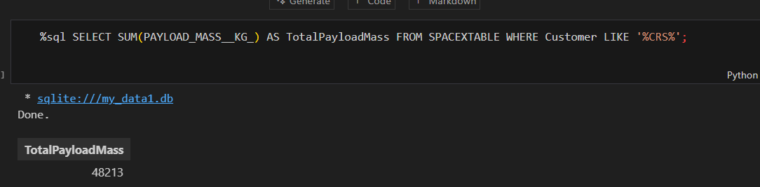
Total Payload Mass
Total payload carried by boosters from NASA

Slide 27
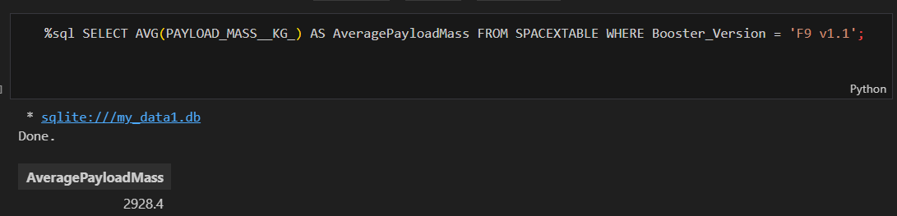
Average Payload Mass by F9 v1.1
Average payload mass carried by booster version F9 v1.1

Slide 28
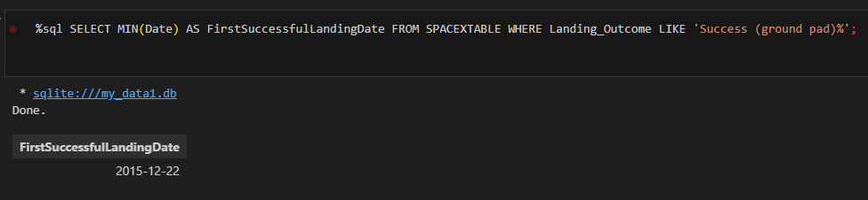
First Successful Ground Landing Date
Dates of the first successful landing outcome on ground pad

Slide 29
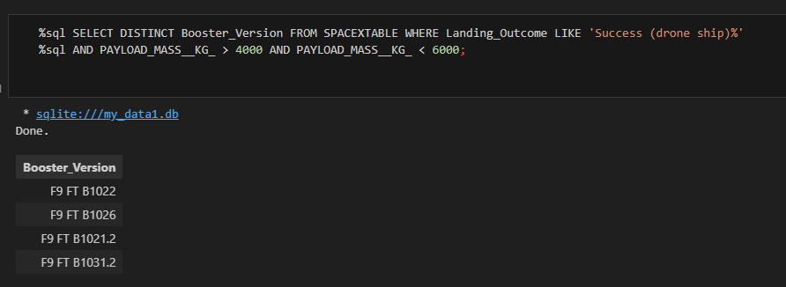
Successful Drone Ship Landing with Payload between 4000 and 6000
Boosters which have successfully landed on drone ship and had payload mass greater than 4000 but less than 6000

Slide 30
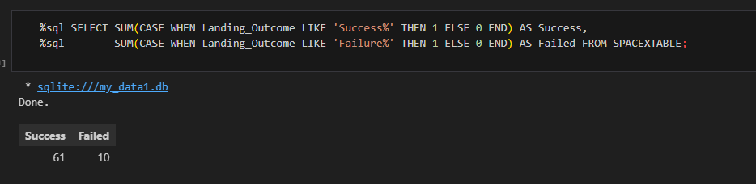
Total Number of Successful and Failure Mission Outcomes
Total number of successful and failure mission outcomes

Slide 31
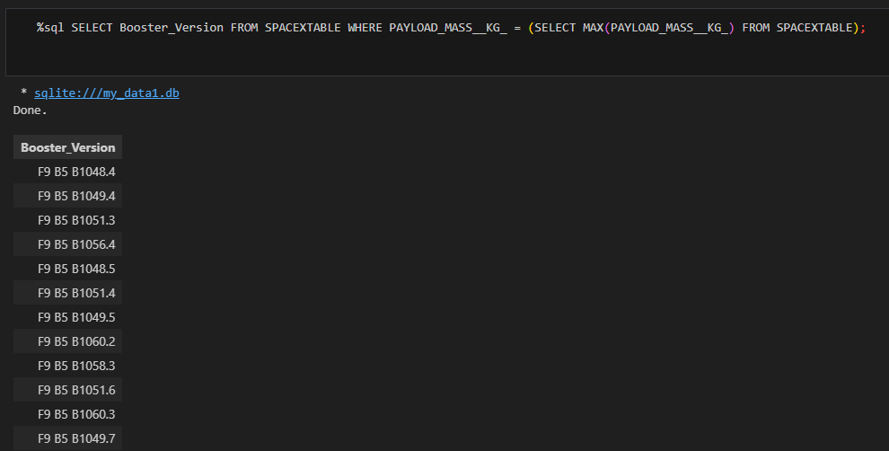
Boosters Carried Maximum Payload
Names of the booster which have carried the maximum payload mass

Slide 32
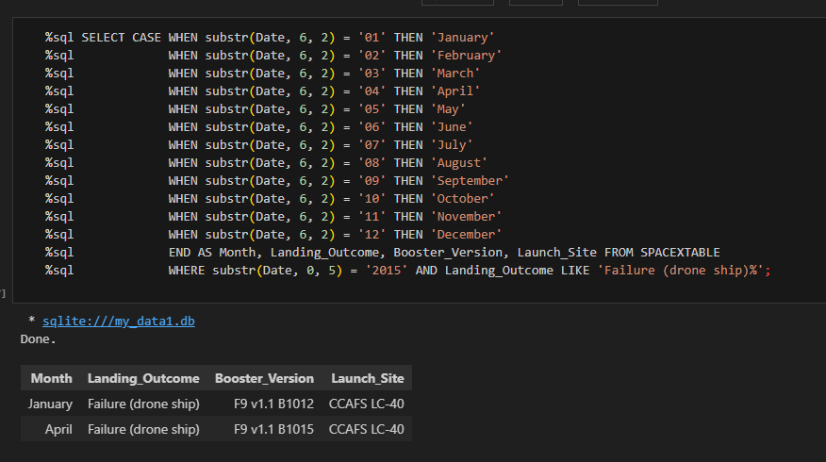
2015 Launch Records
Failed landing Outcomes in drone ship, their booster versions, and launch site names for in year 2015

Slide 33
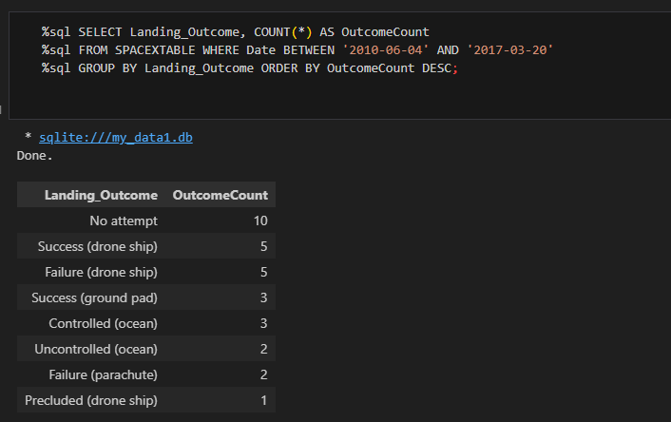
Rank Landing Outcomes Between 2010-06-04 and 2017-03-20
Count of landing outcomes (such as Failure (drone ship) or Success (ground pad)) between the date 2010-06-04 and 2017-03-20, in descending order

Slide 34

Section 3

Slide 35
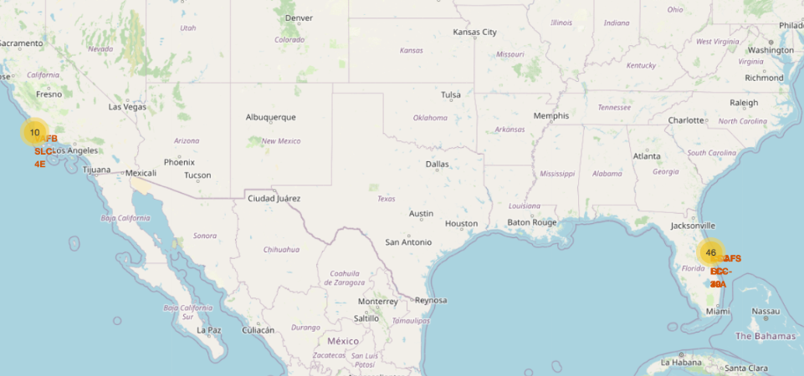
Launch Sites on the Map
Most launch sites are located near the Equator and close to the coastline. This positioning allows rockets to take advantage of Earth's rotation for efficient launches.
Coastal locations also ensure that rockets are launched over the ocean, minimizing the risk of debris or explosions affecting populated areas.

Slide 36
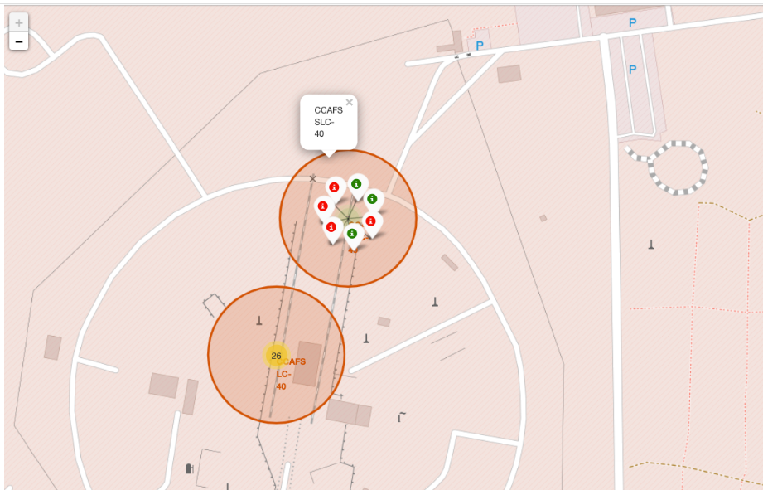
Color-Labelled Marker Clusters
From the color-labeled markers we should be able to easily identify which launch sites have relatively high success rates.
Green Marker = Successful Launch
Red Marker = Failed Launch
Launch Site KSC LC-39A has a very high Success Rate

Slide 37
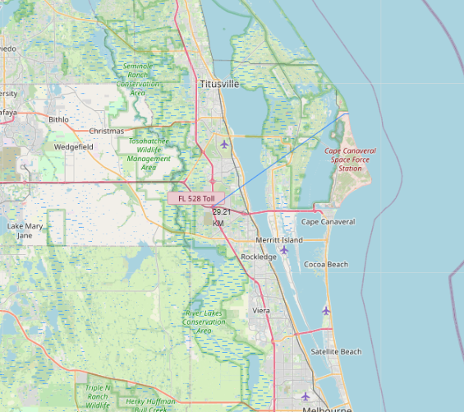
Launch Site and its Proximities
From the visual analysis of the launch site KSC LC-39A we can clearly see that it is
Relatively close to railway (around 15 kms)
Close to highway (around 20 kms)
Very close to the coastline
Close to its closest city
A failed rocket with its high speed can cover distances like 15 to 20 kms in few seconds. It could be potentially dangerous to populated areas.

Slide 38

Section 4

Slide 39
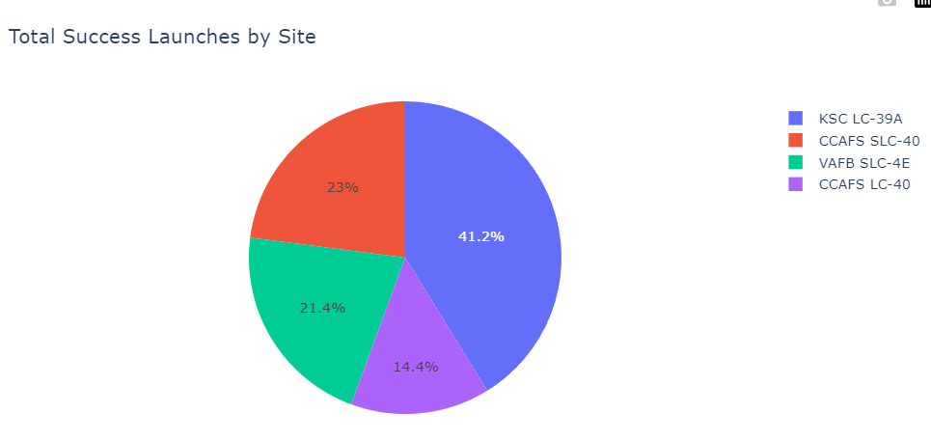
Success across Launch Sites
The chart clearly shows that from all the sites, KSC LC-39A has the most successful launches.

Slide 40
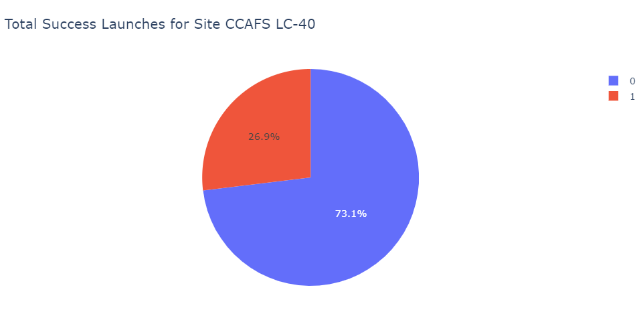
Launch Site with the Highest Success Ratio
KSC LC-39A has the highest launch success rate (73.1%) with 10 successful and 3 failed landings

Slide 41
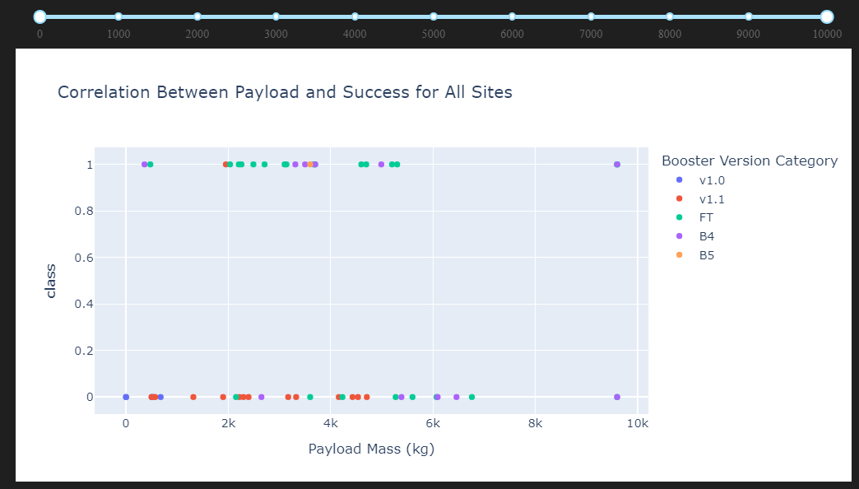
Payload Mass vs Launch Outcome
The charts show that payloads between 2000 kgs and 5500 kgs have the highest success rate.

Slide 42

Section 5

Slide 43
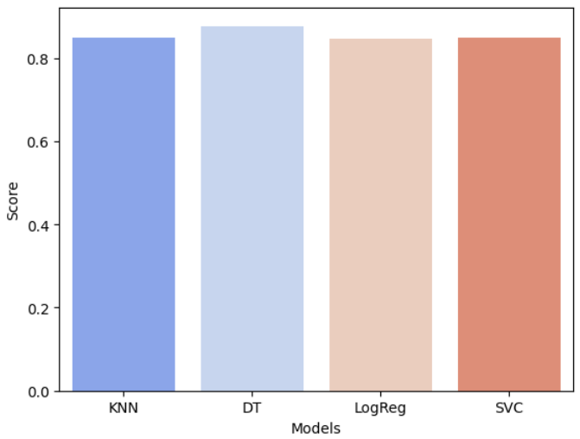
Classification Accuracy
Based on the scores of the Test Set, we can confirm which method performs best.
Same Test Set scores may be due to the small test sample size (18 samples). Therefore, we tested all methods based on the whole Dataset.
The scores of the whole Dataset confirm that the best model is the Decision Tree Model. This model has not only higher scores, but also the highest accuracy

Slide 44
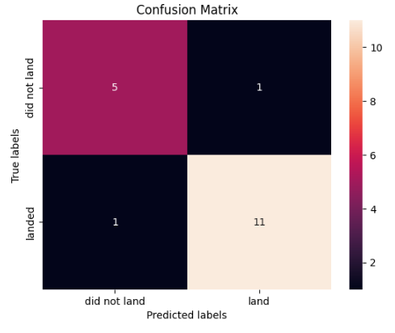
Confusion Matrix
The confusion matrix for the decision tree classifier shows that the classifier can distinguish between the different classes.
High TP Rate: The model correctly identifies most landings (11/12)
Low FP: Only 2 misclassifications(1FP, 1FN)
Balanced Predictions: It successfully identifies both landings and failures, but has slightly more success in predicting landings.

Slide 45
Conclusions
We can conclude that:
The larger the flight amount at a launch site, the greater the success rate at a launch site.
Launch success rate started to increase in 2013 till 2020.
Orbits ES-L1, GEO, HEO, SSO, VLEO had the most success rate and the Launch Site KSC LC-39A had the most successful launches of any sites.
Launches with a low payload mass show better results than launches with a larger payload mass.
The Decision tree classifier is the best machine learning algorithm for this data.

Slide 46


